Slide 1
PLAN B

Slide 2
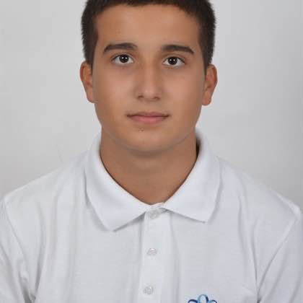
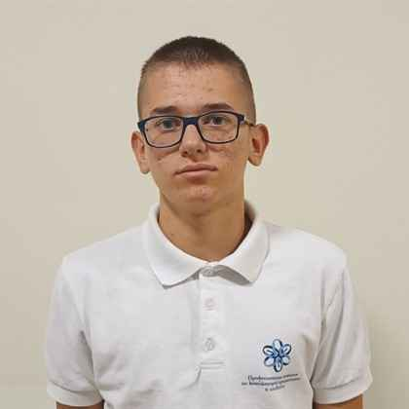
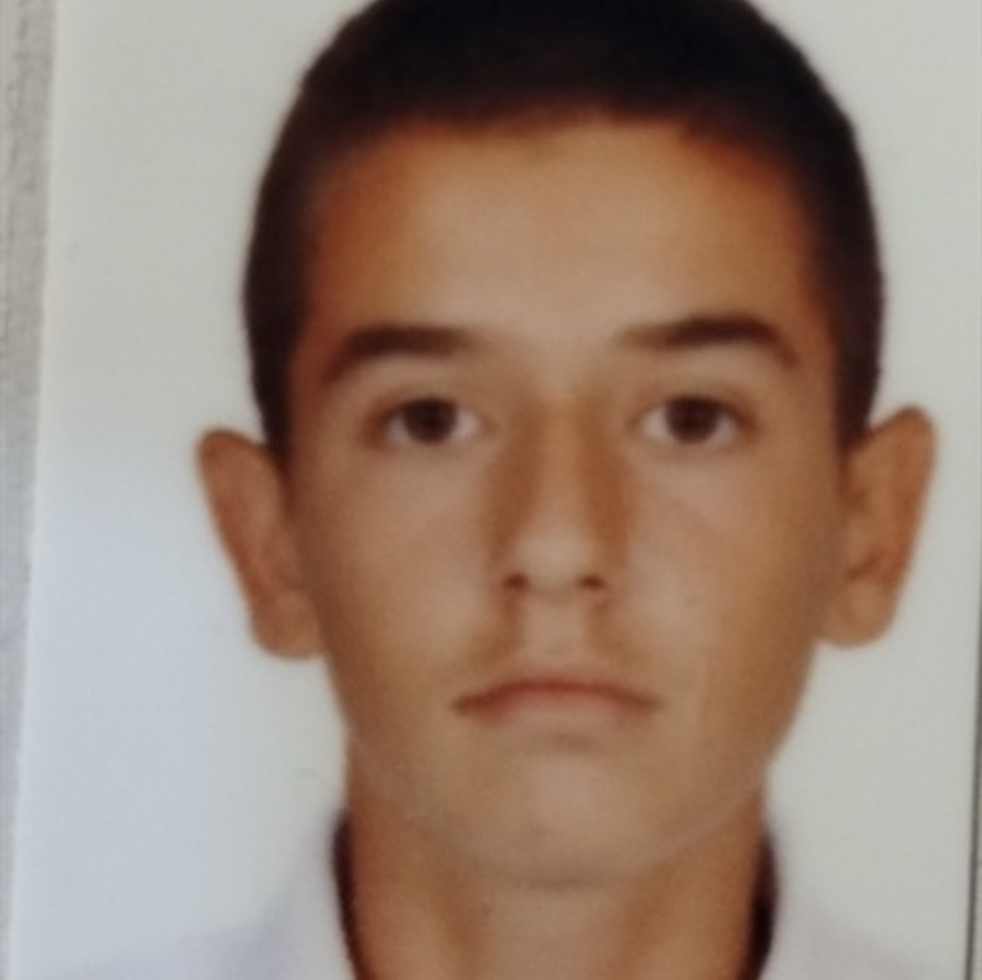
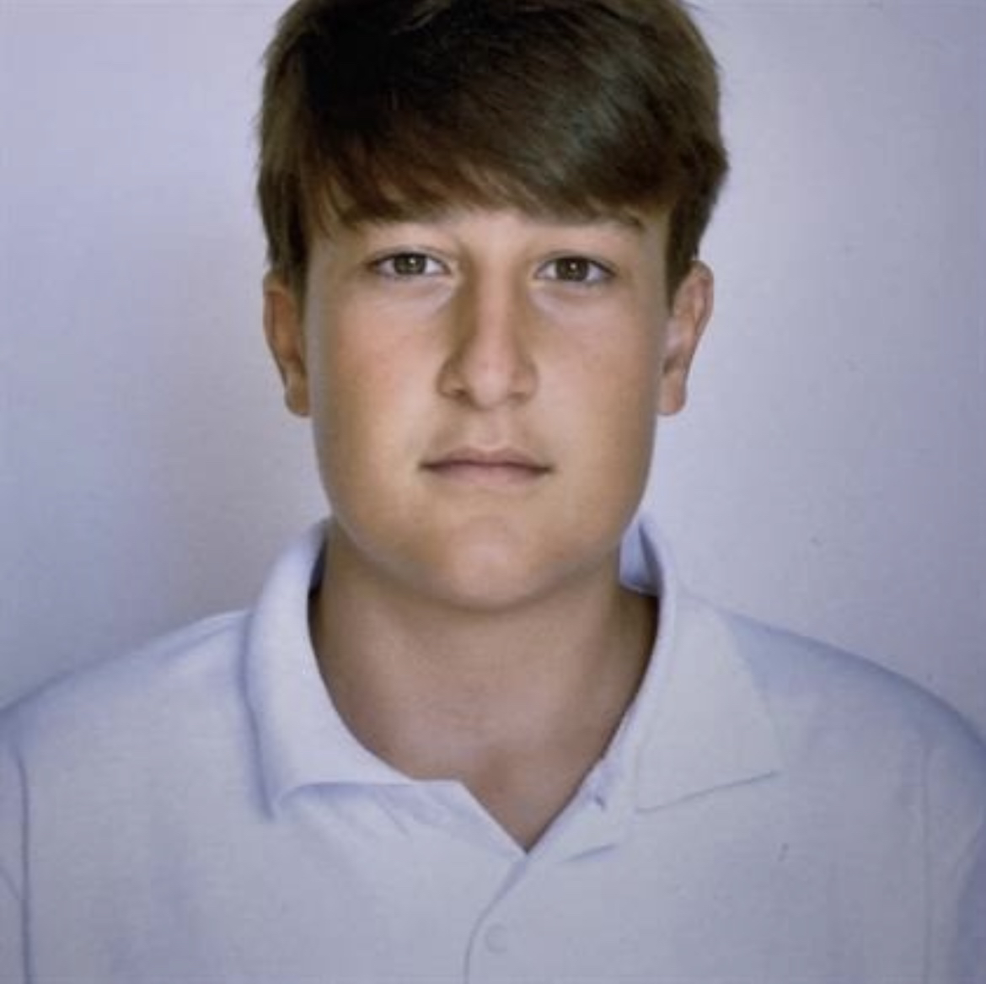
Team
Ivan Ivanov10 B
Backend Developer
Stefan Dimitrov 10 Б
Backend Developer
Mitko Doychev 10 B
Backend Developer
Maxim Mateev 10 B
Scrum Treiner

Slide 3






Used technologies

Slide 4
About the project
Our project is a console application, that make it easy and understandable for the people who are learning new information about the basic Finance Challenges, so they can have better general knowledge.

Slide 5

So let's get into the project

